Slide 1
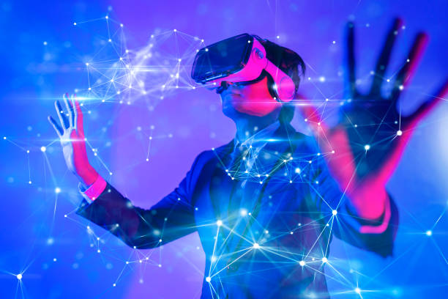
The Metaverse And Web 3.0
By Shehzad Iqbal
@gmail.com

Slide 2
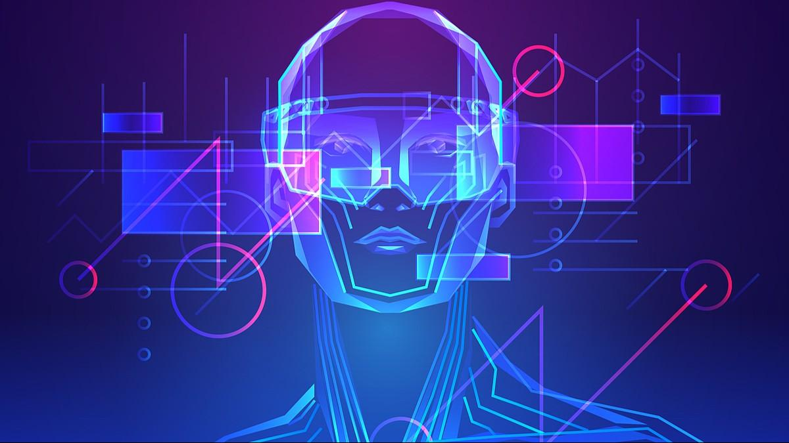
What is the metaverse?
No matter what you believe the term actually means, "the metaverse" is not a single destination. Instead, it will be a massive system that presents an undeniable opportunity for industries across the globe. Meta believes there will be 1 billion metaverse users by 2030.
Jason Yim is the founder and CEO for Trigger XR, an experienced XR developer studio and creative agency.

Slide 3
Big players will lead innovation.
As established telcos and companies launch new devices, services and hardware options, these will lift the entire industry as a whole. Conglomeration is expected as the stakes get higher, from Microsoft's acquisition of Activision to Niantic acquiring 8th Wall.
Apple , Meta , Microsoft and Nvidia.

Slide 4
The Metaverse From A Developer's Perspective.

Slide 5
Perspective
By now, we're all familiar with the term "metaverse." Some believe the term is an immersive virtual reality where we escape the "real world," moving through virtual environments with ease and access. Others believe in the "real-world metaverse" where utility is paramount and where digital information will be layered on top of our physical context. Still, others approach the metaverse with a foreboding, believing it will become a dystopian future without regulations.
The definition of the metaverse is still being debated. However, as the founder of a developer studio and creative agency that's been building metaverse experiences since 2009, I can shed some light on what its near-term prospects hold. At a high level, the metaverse represents the giant shift from looking at 2D content on flat screens to engaging with 3D content in a spatial environment.

Slide 6

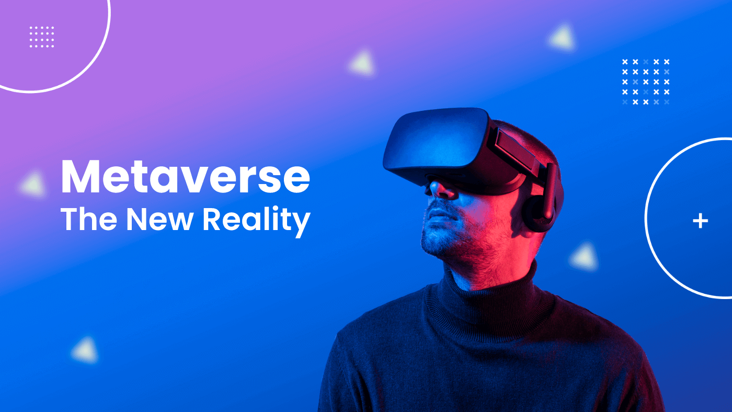
My discoveries
Even though many companies are laying a stake in the ground for an AR- or VR-dominated metaverse today, as a developer, I can tell you they're essentially two sides of the same coin—although AR is far more significant right now.

Slide 7
AR has the advantage when it comes to scale, as over 83% of the world's population is on a smartphone—meaning more than 6 billion people already have access to experience AR. Companies like Niantic and Qualcomm are doubling down on their AR platform capabilities, so developers can easily leverage their tech into building applications. Creators are also building their own Snapchat AR-based filters to allow brands, influencers and individuals to experiment with AR. With all of these advancements, by 2025, about 75% of the global population and almost all smartphone users are expected to be frequent AR users.

Slide 8

Eventually, AR and VR will be two sides of the same coin.

Slide 9
Conclusion
We're really not too far off from when the real-world metaverse and immersive metaverse can intertwine into a truly persistent and mixed reality experience. Imagine walking through a movie theater and interacting with the hero character from the next big blockbuster in AR. That same character can now join you (unlocked) in your next VR game, where you can now defeat a boss enemy (with their help) and collect a virtual key. This key then unlocks a loot box found exclusively back at your favorite movie theater. This is just one example of what's to come when AR and VR will seamlessly integrate and unlock meaningful rewards in both worlds.

Slide 10
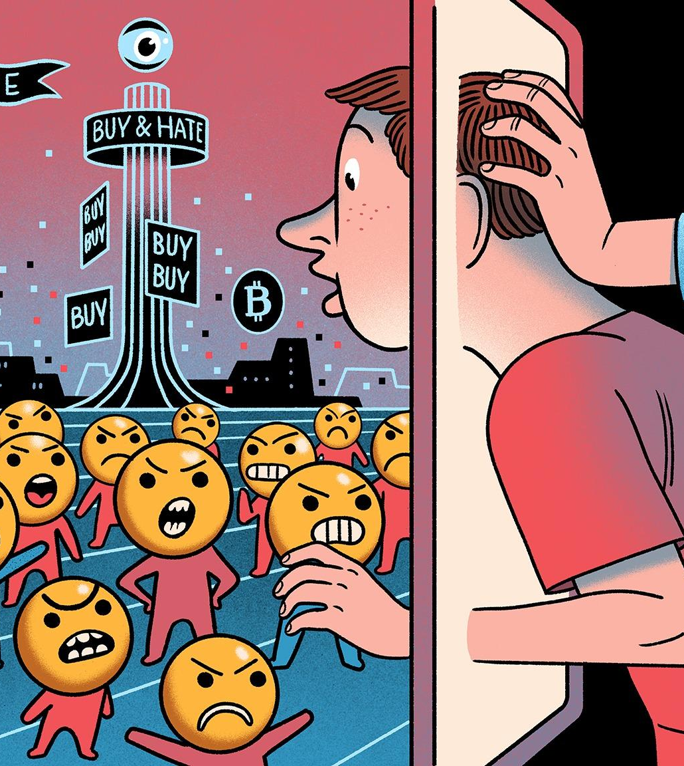
What will I do next?
As a Metaverse developer, one needs to have the skills of creating a digital and immersive world that the users can communicate with. Developers need to build such applications and games which could interact with the users with the help of VI, AR, and AI technology.

